Slide 1

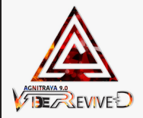
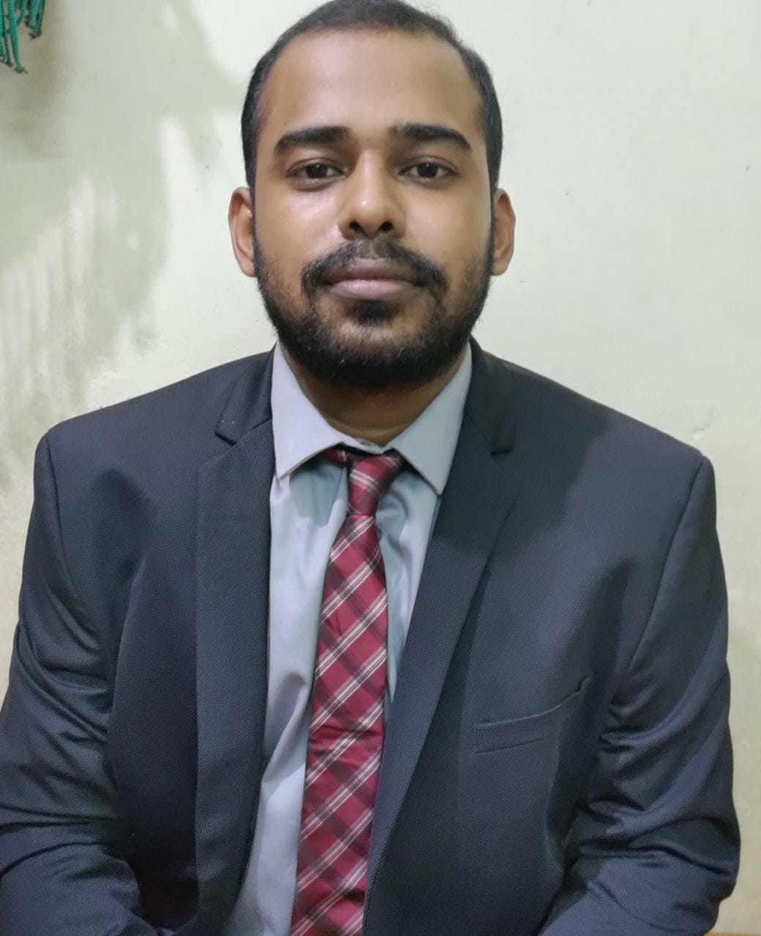
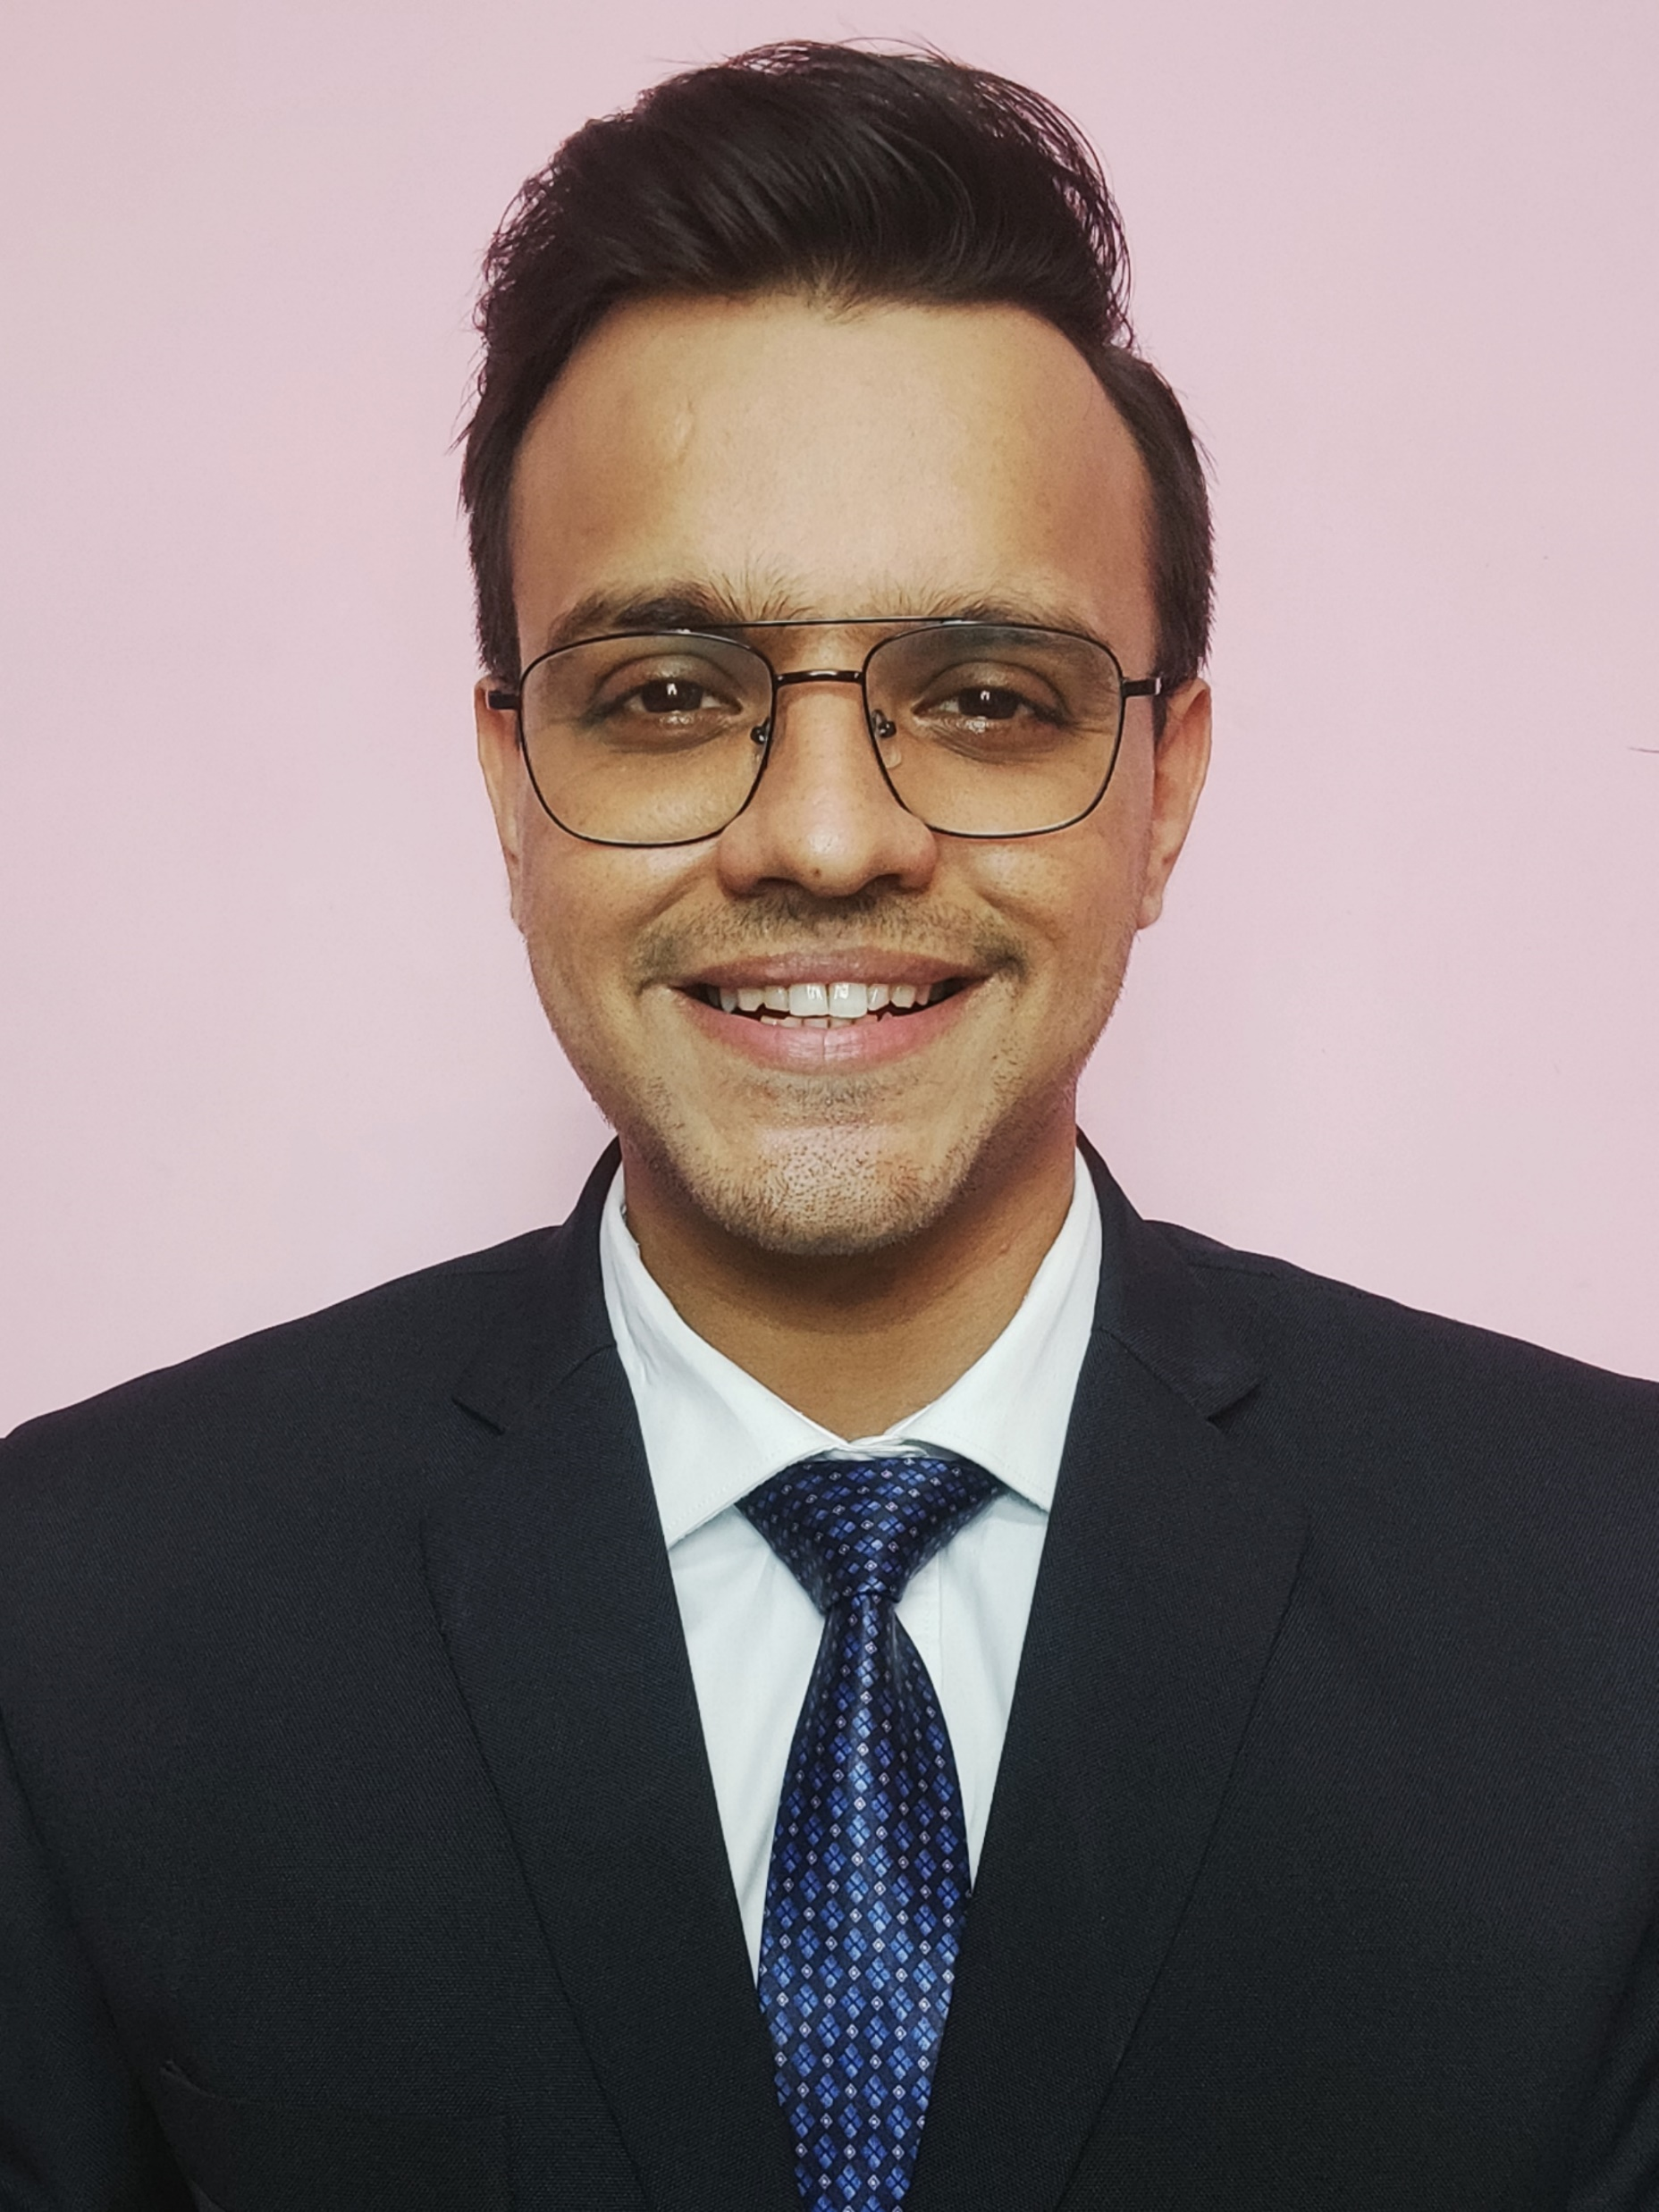
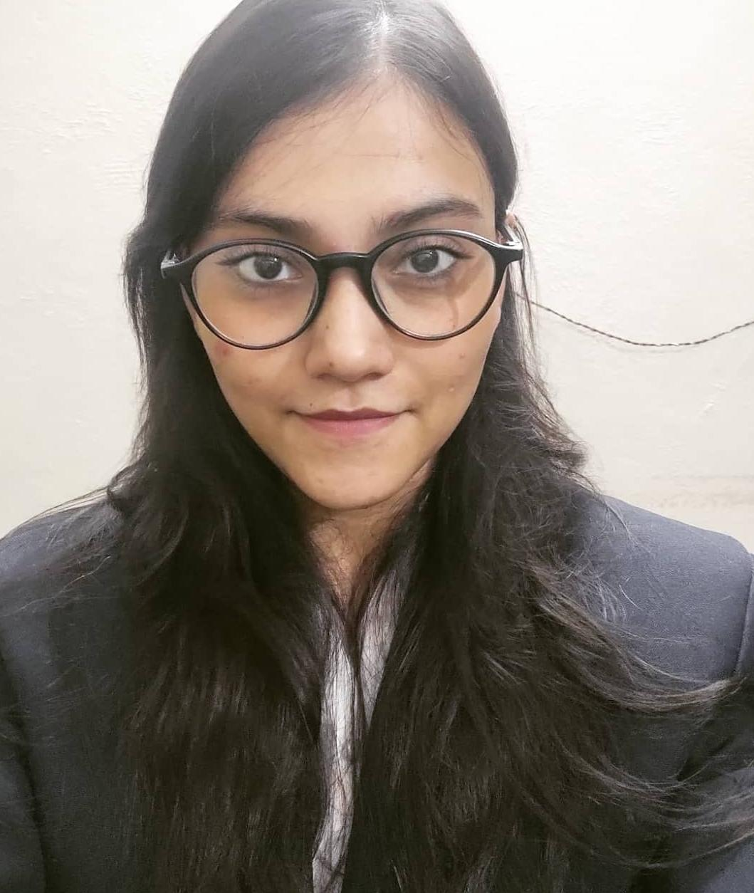
Team SORTED
CONSULTING KNIGHTS CASE STUDY
IMPROVING AVERAGE TIME SPENT
Devesh Sinha Mohit Kiradoo Kajal Gupta
T. A. Pai Management Institute
Notes:
With companies looking for rapid globalization, products and services are getting localised according to the markets as per local tastes and preferences. Dairy Queen, established in 1940, one of the biggest American QSR chains is looking for their expansion into the Indian market. With a vision to be the world’s most favorite QSR chain, let’s see how their entry in India will reinforce their vision.
Good morning……. Future of dairy queen in India.

Slide 2


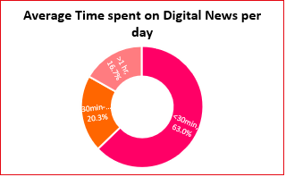
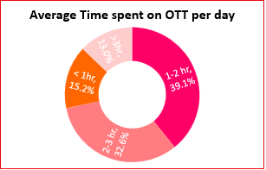
MARKET SUMMARY
USER ACQUISITION
GO TO MARKET
Understanding the usage pattern of the Target Persona
Tier 1
Delhi, Bangalore & Kolkata
Rapid internet penetration
47%
600mn+ users currently
900mn+ users by 2025
Tier 2
Agra, Asansol & Bhubaneshwar
Digital fastest growing medium
5%
Television
26%
Digital
2%
Print
5%
Radio
138
Respondents
59.5%
Males
40.5%
Females
70.2%
Professionals
80% increase in Online/Digital news consumption from 2019
Forecasted to reach 700 mn+ by 2026
Increased digital news access is driving higher time spent on news consumption in India
Growth driven by vernacular content
10%
Annual increase in mins consumed
Movies, web shows and digital news, the main drivers of consumption of English language content
More engaging and relevant content and convenient channels of access leading to consumer centric news models
180mn short video consumers
9x jump from 2020
Lower barriers to entry
High viewership for niche news players
19% of respondents prefer vernacular content for news
Majority of working professionals look for byte sized news content due to less view time
Few respondents demand structured and short content and references to know about developing events in various industries
Digital Natives and other small publishers offering niche content and monetizing via subscriptions
News aggregators licensing content from publishers and re-packaging, synthesizing, and recommending content
There is lack of structured byte sized content from digital natives or news aggregators, to cater to specific segments of the target population. Vernacular content can prove to be a game changer for platforms, as it gains traction from Tier 1 cities down to Tier 3+/ rural areas

Slide 3





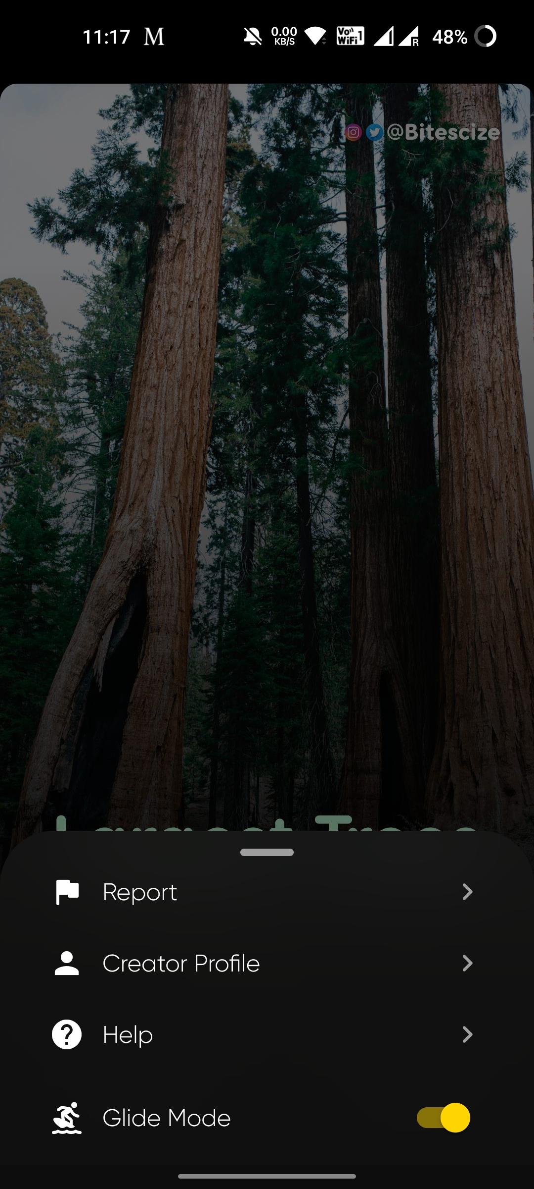

MARKET SUMMARY
USER ACQUISITION
GO TO MARKET
PERSONA
Vivek Bharti
Civil Services Aspirant
27 yrs old, Kolkata
Raunak Ray
Undergrad Student, Football fanatic
19 years old, Asansol
Akash Gupta
Working Professional, 5 years in IBM
29 years old, Bangalore
USAGE PATTERN
News > 3hrs per day
Spends 1-2 hrs on Movies & Web shows
Has subscription of Netflix & Amazon Prime
Reads about global events from Mint, Indian Express & the Hindu
News 30min-1hr per day
Movies & Web shows > 3hr per day
Has subscription of Netflix, Amazon Prime & Hotstar
Fascinated by Peter Drury, aspires to become a football commentator
News 30min-1hr per day
Movies & Web shows 1-2 hr per day
Has subscription of Netflix & Amazon Prime
Reads about global events from Inshorts, Money Control and few newspaper specific apps
PAIN POINTS
Has to search for relevant news articles from multiple apps
Prefers short and crisp content for few industry based events
Has to search for references for in-depth knowledge about certain historic events
Has to search about major football updates on multiple apps
Wants to know about historic football events, finds tedious task to search
Wants videos or clips linked to specific content to expand knowledge
Has very busy schedule prefers byte sized content to get updates
Wants movies or shows related to major global happenings
Has to perform tedious search for funding events and updates (wants to build a startup)
Introducing Netbriefs, an app with cumulated specific industry based events at one place and links these events to certain references like Movies & Web Shows on Netflix, thus increasing content consumption
Developing the user acquisition strategy for
Show creators
Content Provider
$
Customers
Recommended Roadmap
Limited License
$
$
Data
References
Month 1-4
Month 5-12
Month 12-24
Value chain to drive a content driven strategy for user acquisition on the platform
Acquiring content creators
Multiple creators on YouTube create event specific content which garner high viewership among users. NetBriefs would acquire their content to develop byte sized content, typically in form of infographics or short videos (<1 min or 1-2 mins, depending on the event). These events would then have references, linking to movies or shows or documentaries which depict or portray these events. These links to be added to Netflix watch list. Use the 3Vs: Voice, Video and Vernacular to promote high interaction
Bundling the subscription plan
Promotional activities for awareness
Documentaries or clips to drive engagement

Slide 4




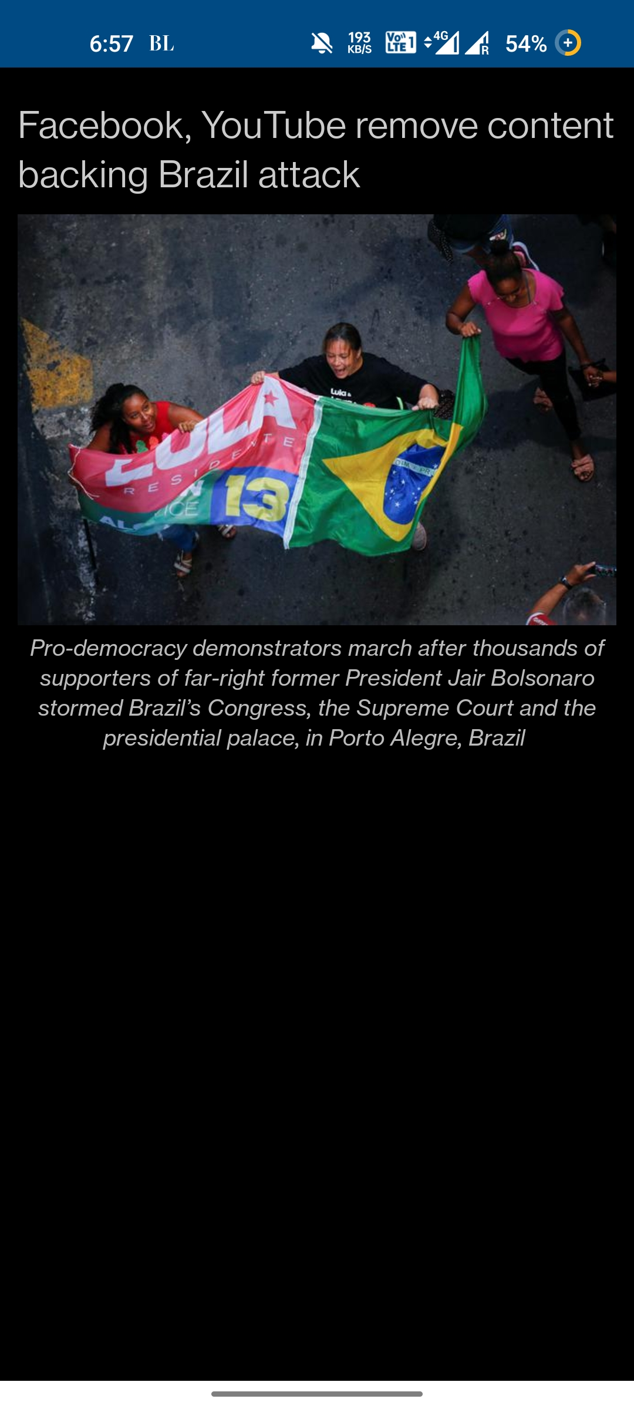


MARKET SUMMARY
USER ACQUISITION
GO TO MARKET
Few Promotional Advertisements
TARGET MARKETS
MARKET PENETRATION STRATEGY
CHANNELS/PARTNERS
Netbriefs to be launched in Pan India, however the product is targeted for Tier ½ cities, for the younger and working population as it majorly caters to their needs;
Leveraging vernacular content for mainly Tier2+ cities
Using the existing customer base to promote content on Netbriefs;
Bundling the app with the existing Netflix subscription to promote usage;
Promotional activities on social media, outdoor advertising and hyper-personalization
Content creators on YouTube, Instagram and news editors;
Social media partners include Instagram and Twitter;
Outdoor advertisements on billboards
App notifications and emails to promote hyper-personalization
Be wary of your pockets, know more on
Feature Development
A/B Testing
Improvement
Awareness
Release
We don’t remove, we add content!
Price Bundling Advertisement
Proposed Feature to be developed by the development team in collaboration with Product Owner and tested thoroughly by QA team.
Feature to be rolled out to specific user groups. Features under test: Swipe mode, glide mode, topic tab, reference
Improvements to be made based on responses received by user groups
Leveraging Netflix customer base to increase awareness; Increasing visibility across platforms with the posts on their social handle
Final release of the product after addressing the modifications and bugs
&
Now get along with your NETFLIX subscription

Slide 5


Slide 6
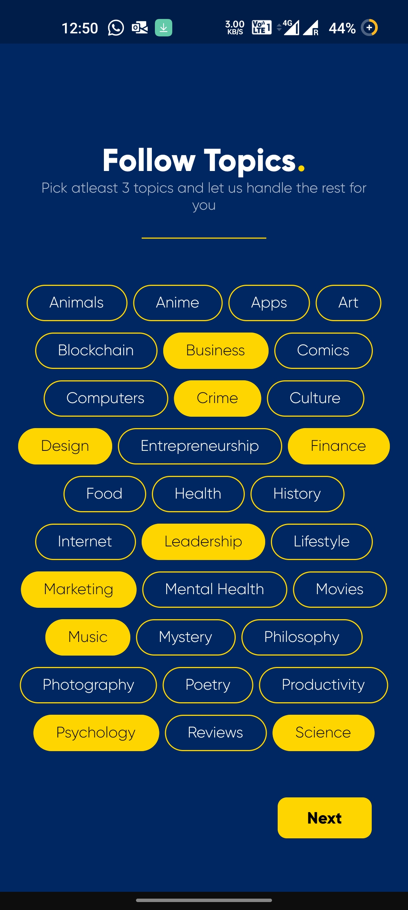
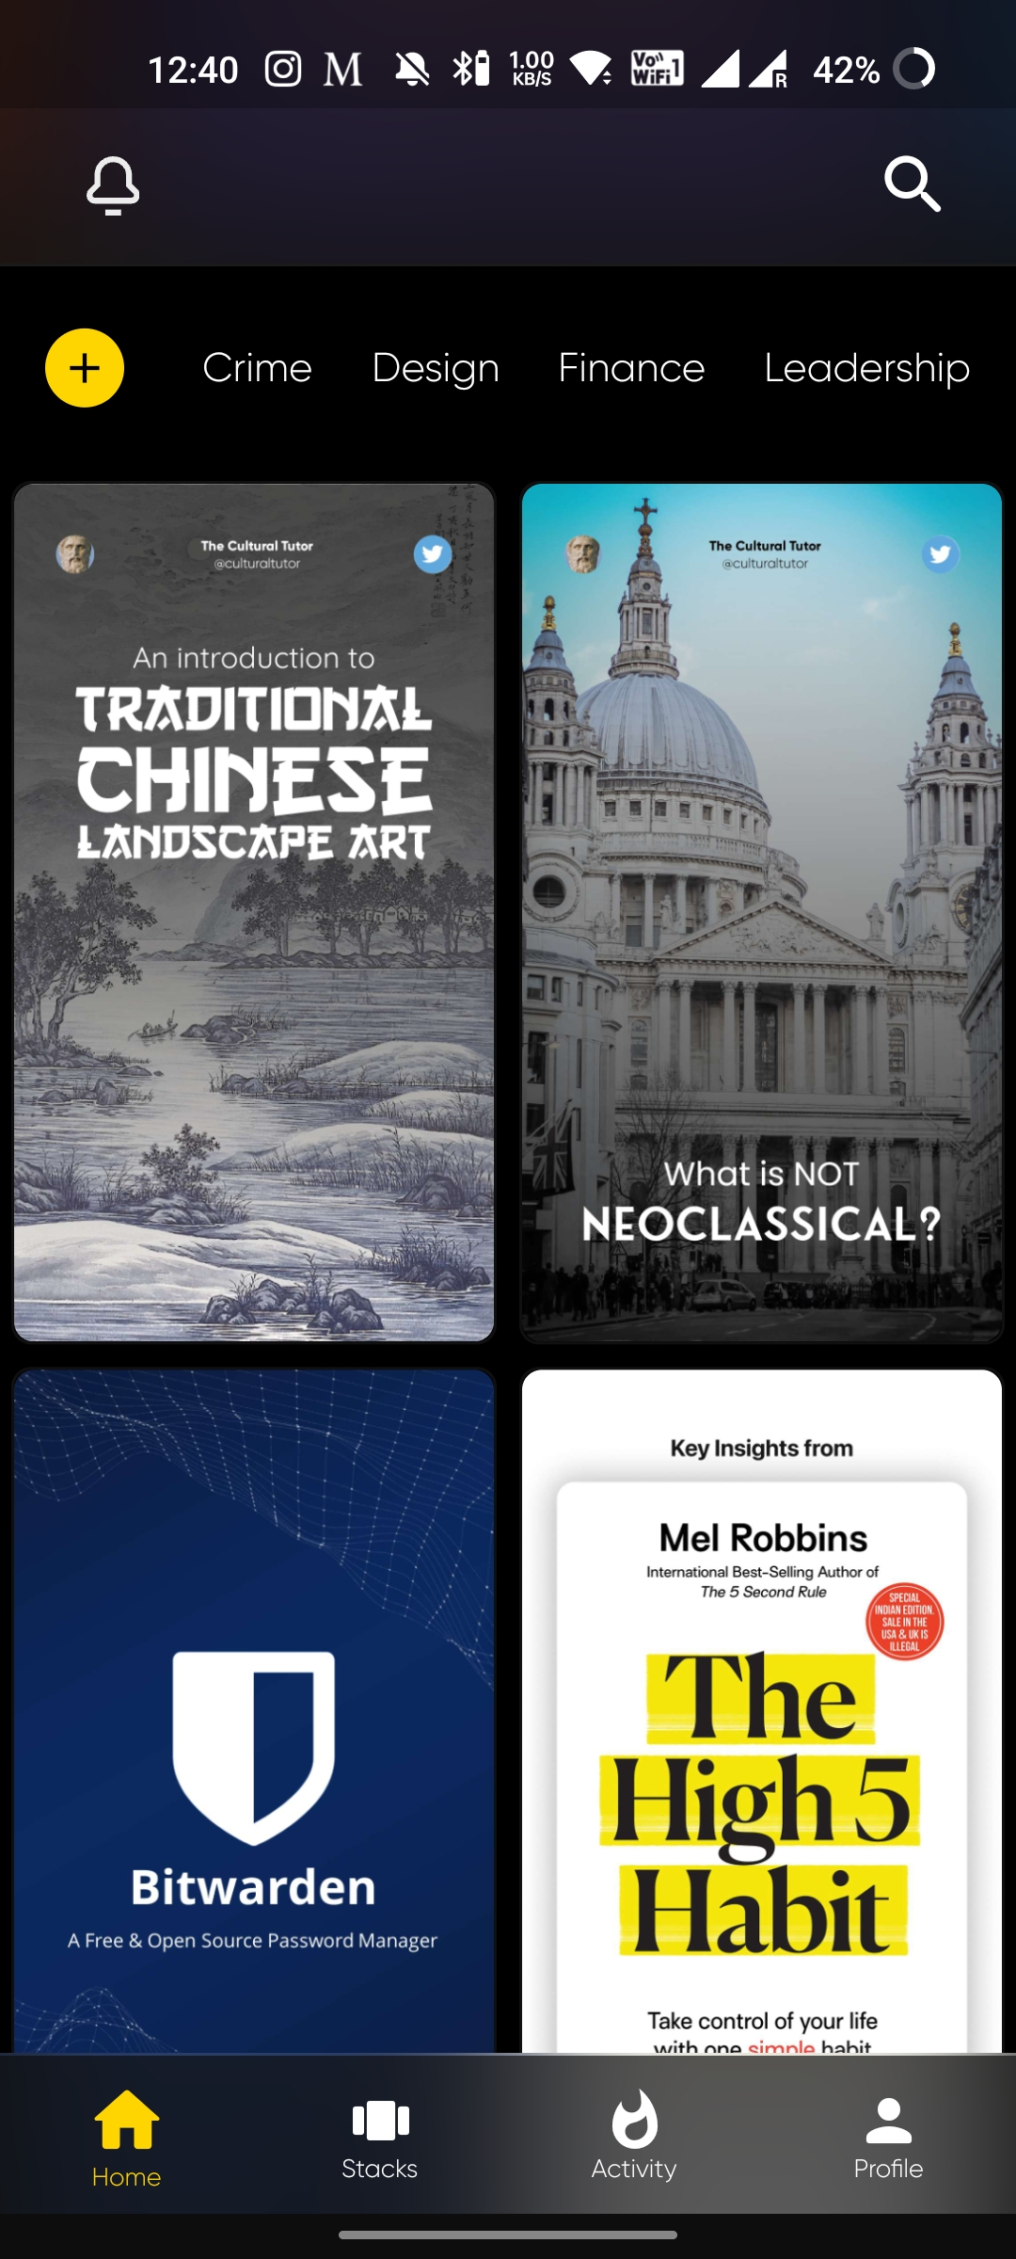
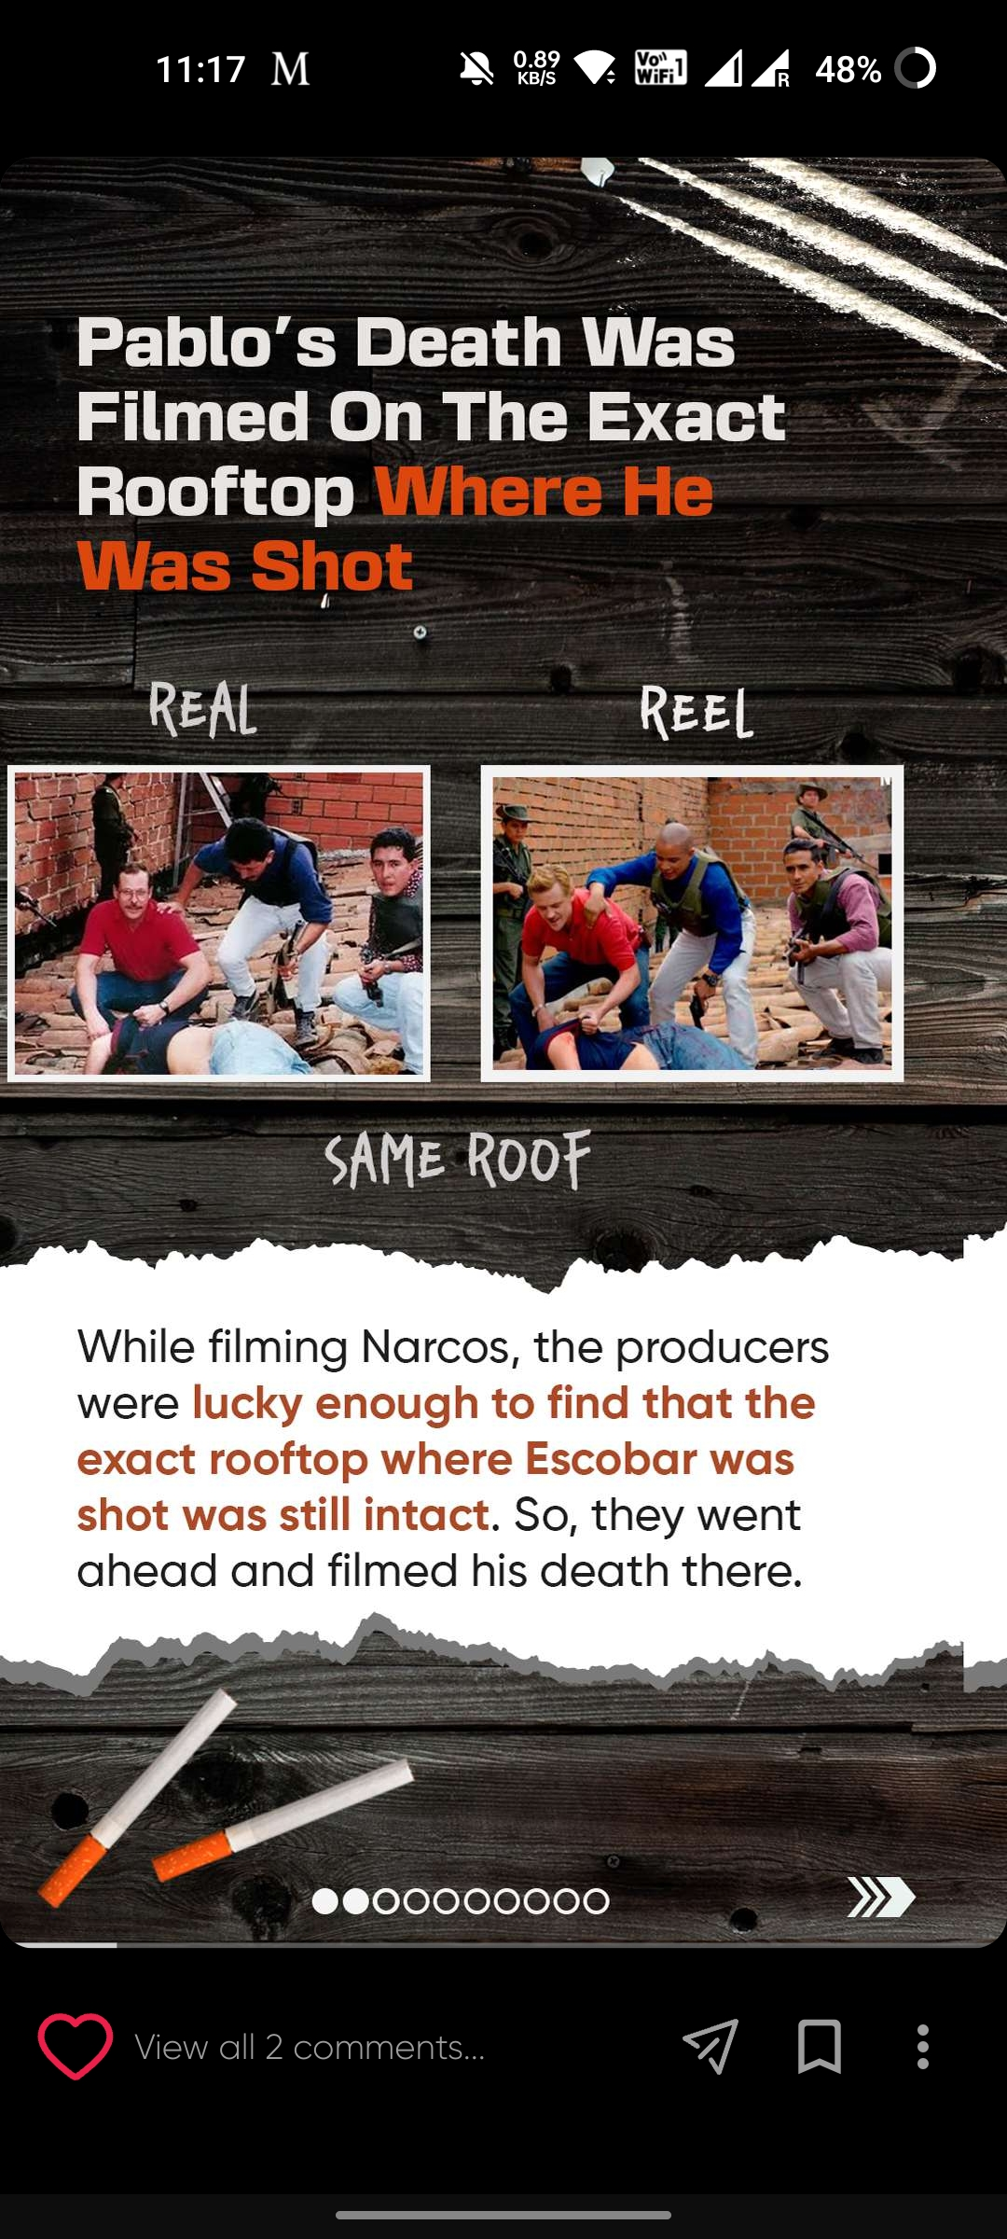
Users can select from a range of topics they are interested in
Above is a reference, each tab is to be replaced by industry
The topics would be available as tabs on the home page of the app
Glide mode to be introduced as a feature to enable immersive infographic read about the events

